Slide 1
Composting and Garden Creation
Student Name
Institution Affiliation
Notes:
Hello, our names are (Student Names). We delighted to have you all. Kindly welcome to our presentation.

Slide 2
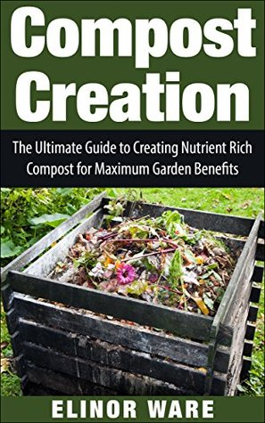
Purpose of Presentation/Overview of Contents
To conserve the environment through waste compositing
Cut down financial cost used in waste collection
Increase food production in the university
Promote people’s heath through use of compost fertilizer
Sustain a clean environment thus creating a good learning environment
Notes:
Our greatest motivation of coming up with this proposal is to see all the waste from the dinning well utilized for the benefit of our university and all other stakeholders. This presentation will cover the importance of conserving the environment though waste composting. There are various aspects associated with waste composting that we will be putting more focus on. We will be outlining the financial costs, food production, health and environmental sustainability. All these aspects are related to waste composting hence remains our greatest focus.

Slide 3
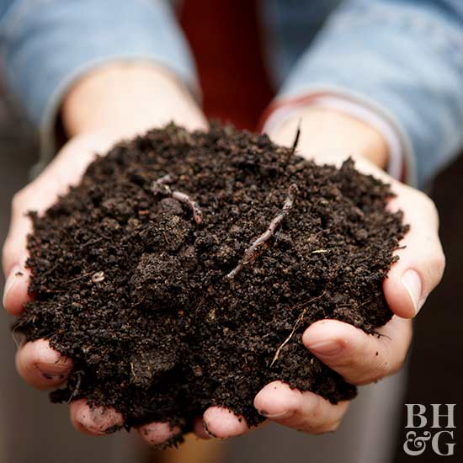
Outline Research Leading to Recommendation
Research carried out involved researching on different scholarly articles on waste composting subjects
Close examination of waste handling process at the university dining halls
Interviewing students on their perspective regarding waste management at the dining hall
Notes:
Research is much important and helps individuals to come up with the best recommendation's and conclusions. Physical, empirical, and literature reviews play the greatest part in research,. Before coming up with our recommendations, we examined different peer reviewed articles on waste composting. The articles gave us a greater view on waste composting and we were able to outline the gaps that other researchers left unfilled. Additionally, we closely monitored the waste handling process in the university dining hole and outlined some of the loopholes in their process. Lastly we interviewed different students to offer their perspectives concerning waste management in the school dining hall.

Slide 4
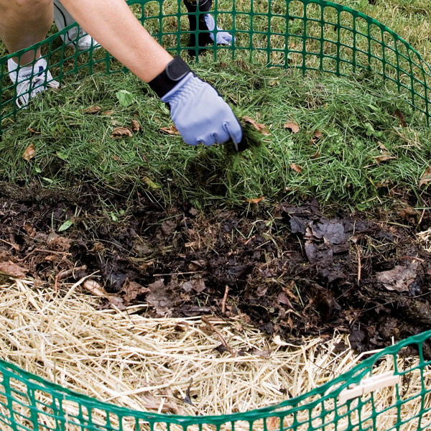
Outline Research Leading to Recommendation Cont'd
Studying examples of institution where waste management sustainability project has been effective
Literature reviewing of the UI Green metric ranking method to determine the success of sustainability project
Carrying out discussions with school administration on their view towards waste management policies.
Notes:
As part of our research, we went further to study different learning institutions that have applied the waste management sustainability projects successfully. We noted down the areas of success to incorporate in our recommendations. Additionally, we also conducted some literature reviewing of the UI green metric ranking for better conclusions. Lastly, we approached some of the university staff to get their views about the efforts towards waste management policies.

Slide 5
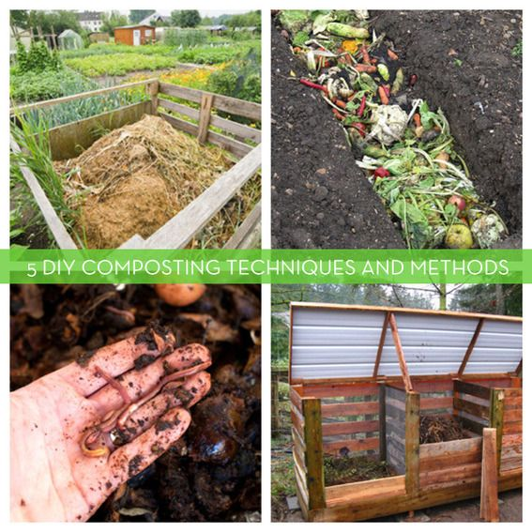
State Recommendation/Project Idea
Solving the problem of waste management in Southern New Hampshire University based on environmental concepts
Closely liaising with school’s administration for proper utilization of school land resource
Cutting down the cost for waste management
Having zero wastes in our project
Application of triple bottom line framework in our project
Notes:
Our proposal goes further to discuss the state recommendations on waste managements. It is essential for the university to solve the problem of waste management that is currently being faced. The university needs to closely lease with all other learning institutions to help come up with the best strategy ever possible. Additionally, it is essential to ensure that all aspects are applied to help cut down the costs of waste management. All projects carried out within the institution needs to be zero waste and the triple bottom line framework be effectively utilized.

Slide 6
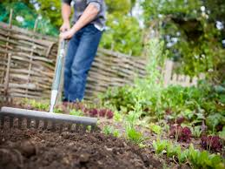
State impact on SNHU and linkage to TBL (Triple Bottom Line)
Project creates a good learning atmosphere which is a social aspect as provided for in TBL
Through waste composting, organic fertilizer which is environmentally friendly as well as conserving the soil is enhanced
The project cuts down cost used to pay firms which are involved in waste and garbage collection hence being in line with TBL financial requirement.
Notes:
As provided by TBL, all projects within the University usually create good learning atmosphere hence promoting the most essential social aspect. waste composting enhances environment protection since some rich minerals such as the organic fertilizers are produced to enhance soil conservation. The project also will effectively cut down all costs that the University incurs in paying firms that collect waste from the institution.

Slide 7
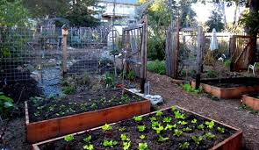
State Realistic/Measurable Objectives
Promote environmental conservation
Ensuring school dining halls are conducive and clean environment where students can take their meals
Promote health through production of chemical free crops due to the use of organic fertilizer
Notes:
Our proposal comprises of three major measurable objectives namely promotion of environmental conservation, ensuring clean dinning halls, and heath promotion. Achievement of all these three objectives would much help in ensuring that all stakeholders benefit from the project. Additionally, the university will be a good example to other learning institution that need to come up with waste management strategies for environment sustainability.

Slide 8
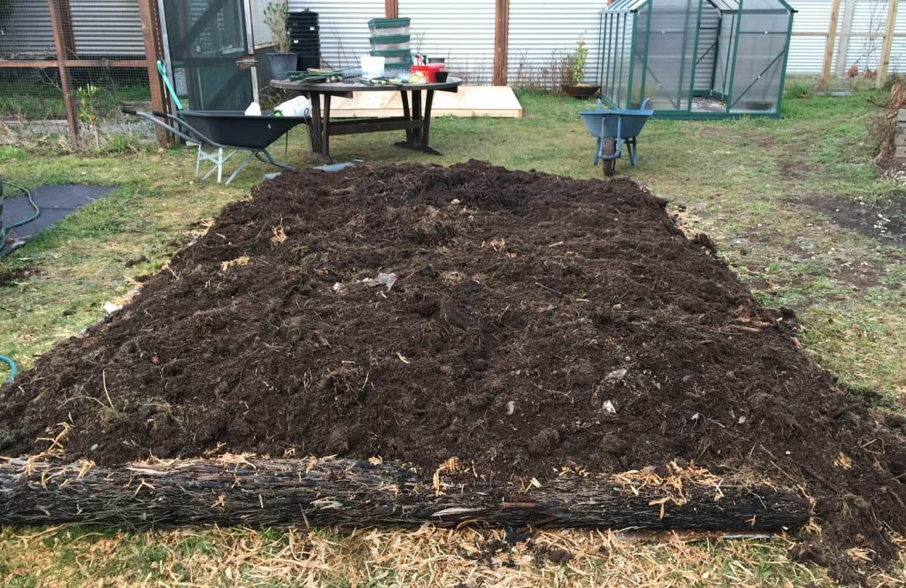
Discuss Strategy/Tactics (project content)
Waste composting is a project whose main aim is ensuring sustainable learning environment in the university
This aspect is achieved through working close with the administration of the institution where a portion of land is necessary for the implementation of the project
Notes:
The main aim of the waste composting project is to create a sustainable learni9ng environment for all students and other stakeholders of the university. The project can not only be achieved through its implementation in the university especially the dining hall, but also all stakeholders including t6eh administration and the local government should work closely together to ensure that the best strategies are achieved.

Slide 9
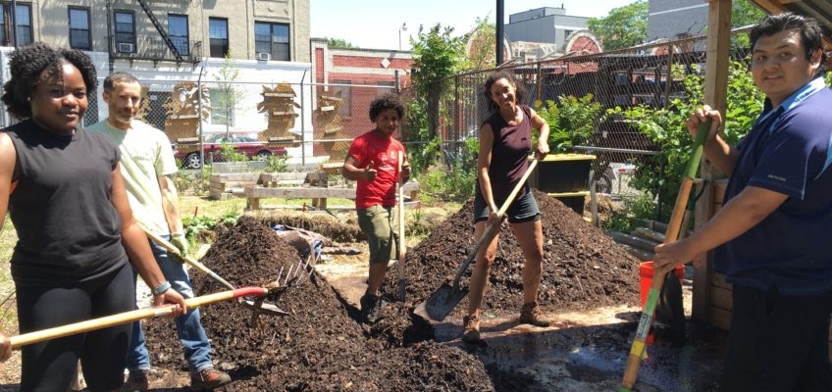
Discuss Strategy/Tactics (project content) Cont'd
The project also employs the strategy of working closely with student leaders where they will help in requesting the administration to recommend our project in 2020-2021 academic year
Time guidelines are also set and they help in keeping the project members alert as well as informed by knowing which activity is to take place, at what time and location
Notes:
Since students are mostly affected by this project, they all need to directly participate in its implementation. Therefore, the student leaders will be ion the front line to make discussions with the administration for the project to be included in the next academic year university goals. Additionally, for quick and effective implementation of the project, time guidelines are set.

Slide 10
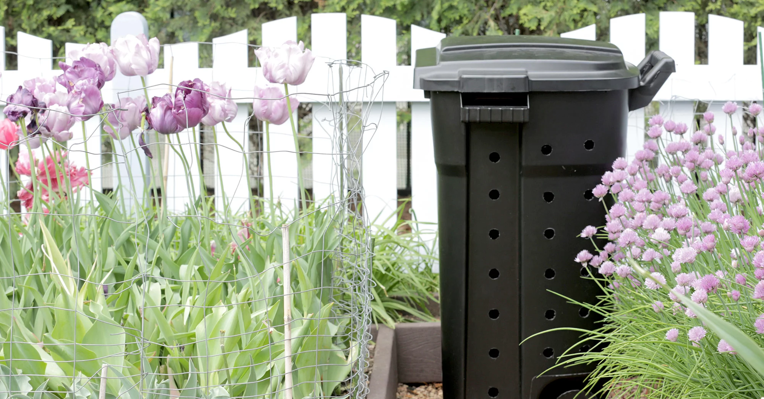
Conclusion
The project majorly focuses on the environmental aspect which is not only a topic of concern to the university but to the whole nation as well
Food production will also increase through garden establishment where compost fertilizer will be utilized
The project is in line with TBL guidelines as well as leaving zero waste products hence worthy approval.
Notes:
In conclusion, the proposal majorly focuses at maintaining a sustainable environment within n our university. We believe that adoption of this proposal in the university will be a greater light to achievement of national sustainable environment. Food production is expected to increase and due to less waste, the health of individuals will be improved, The project remains in line with the TBL guidelines and the zero waste products hence remaining worthy for approval.

